Slide 1
Ichimoku Cloud Crash Course
By @Cryptocred

Slide 2
DISCLAIMER
This is not financial advice. Trading is a very risky endeavour and can result in tremendous losses. Contact a licensed professional for advice.
This is me sharing my personal opinion and personal interpretation of a system I’ve had NO FORMAL TRAINING IN.

Slide 3
How do I set it up?
Adjusted settings (10/30/60/30)
Doubled for conservative signals
Adding to favourites

Slide 4
P.S. Huge h/t to @CarpeNoctom, @LedgerStatus, and the Blockchain at Berkeley course!
A lot of the strategies in this presentation I’ve learned from these guys and from the course, so follow them both and I heartily recommend investing in the BaB course.
Link (non-sponsored & not a referral link) - https://bab.teachable.com/courses

Slide 5
What am I looking at?

Slide 6
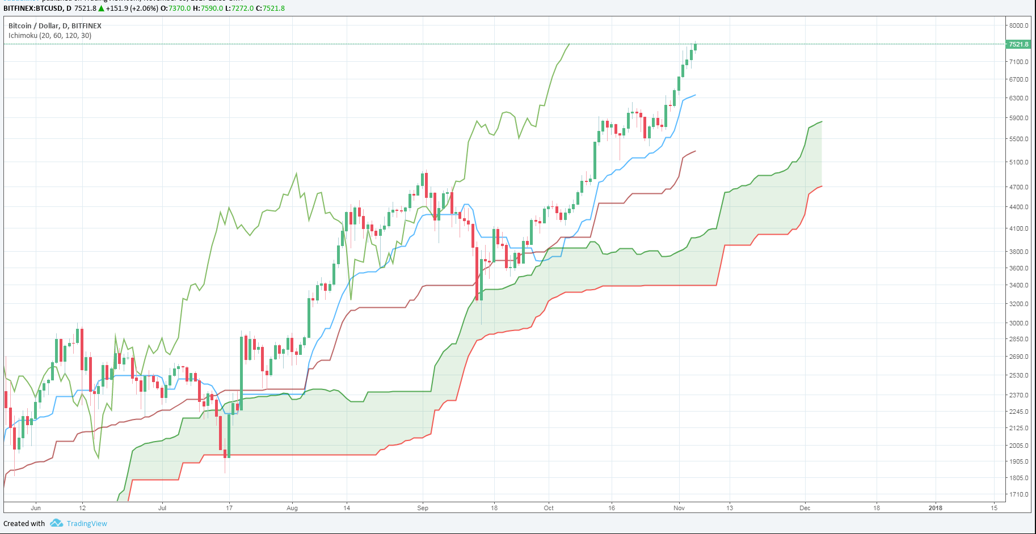

Slide 7
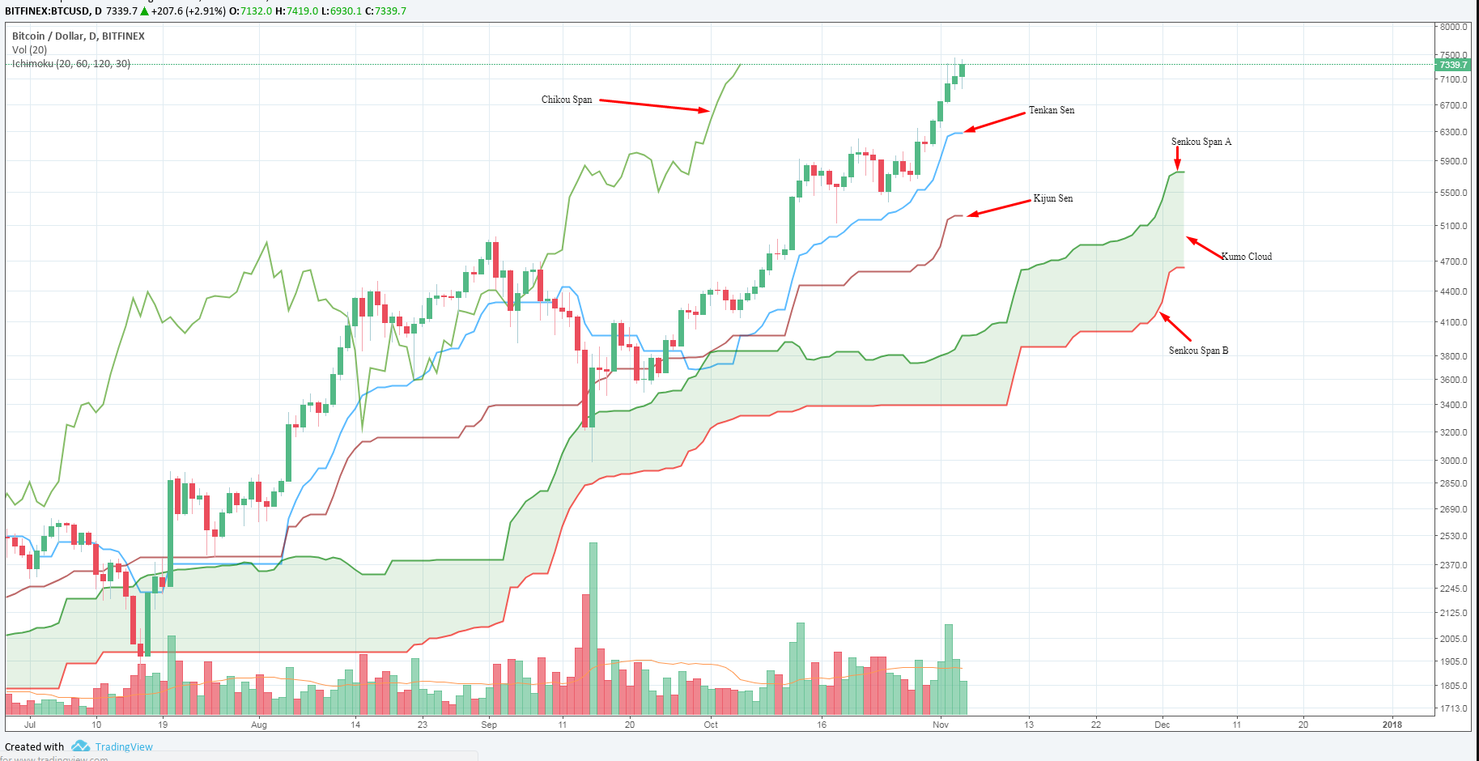

Slide 8
How do I find support and resistance?
The Kumo Cloud (especially flat Kumo)
The Kijun Sen
The Tenkan Sen
Can be integrated very well with trend lines/patterns/horizontal levels etc.

Slide 9
BTC/USD 1D - Kumo Cloud acting as support

Slide 10
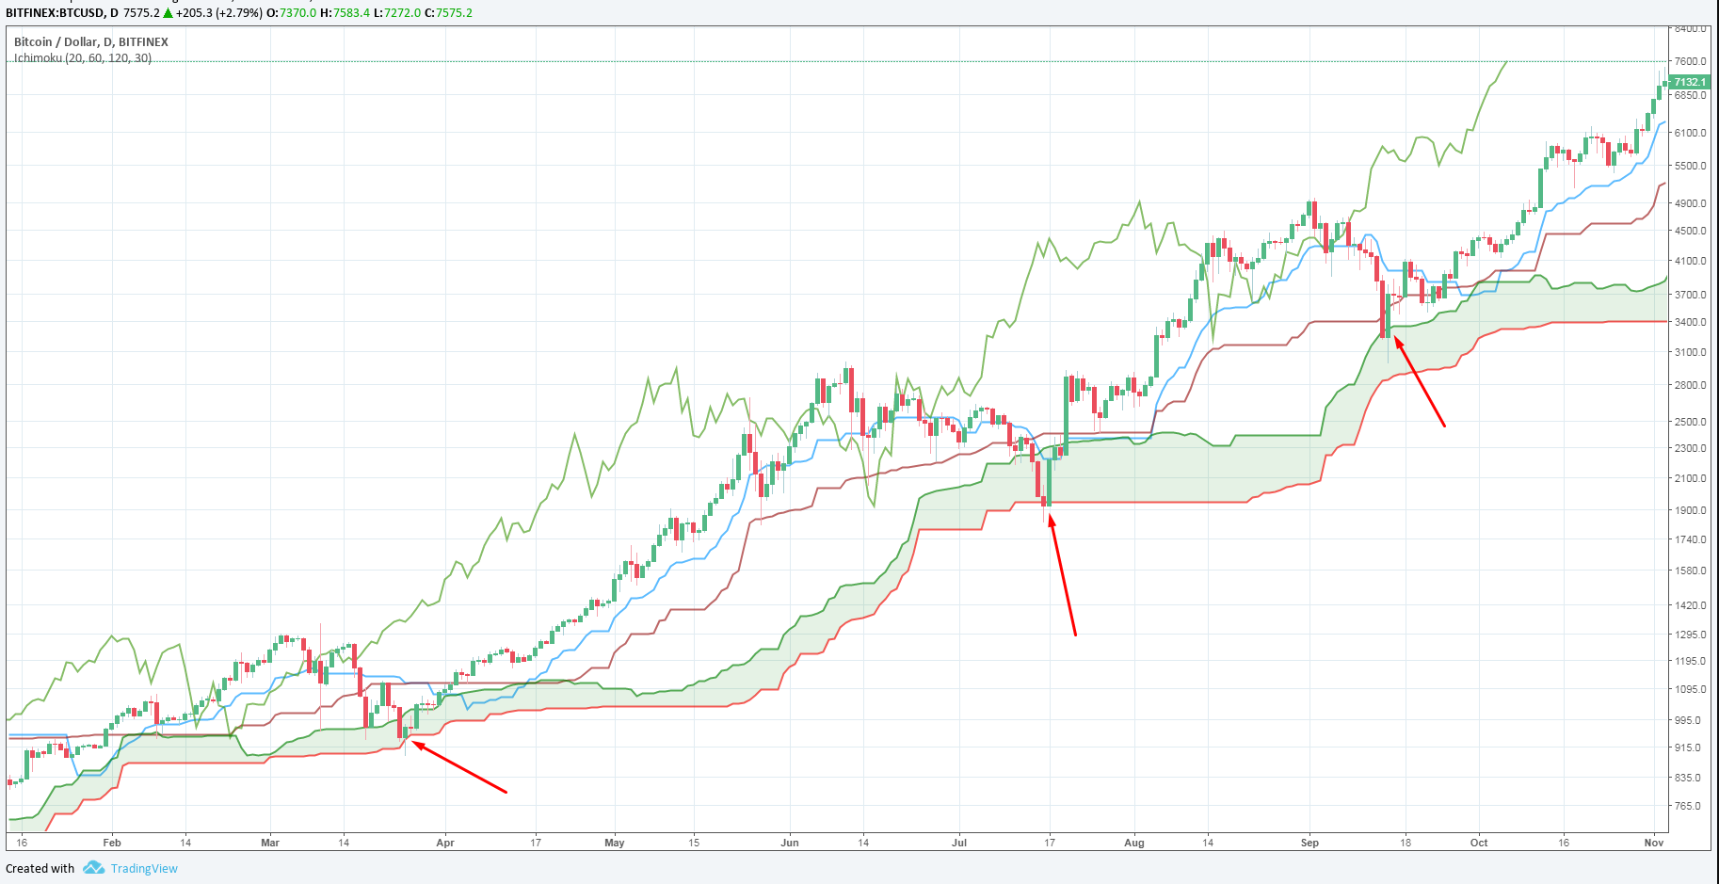

Slide 11
Kijun Sen acting as support - OMG/BTC 4H

Slide 12
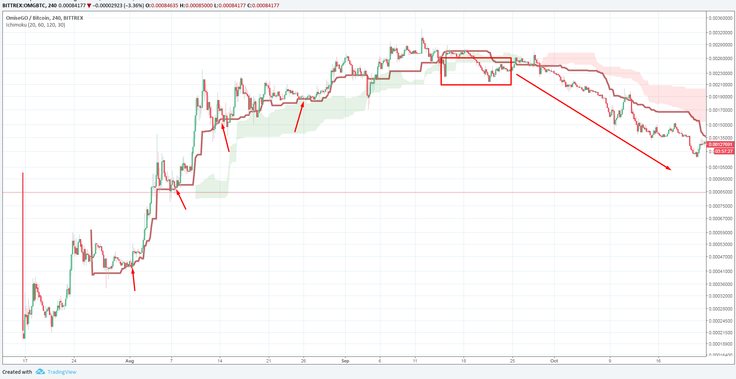

Slide 13
ARK/BTC 4H - Kumo Cloud acting as resistance

Slide 14
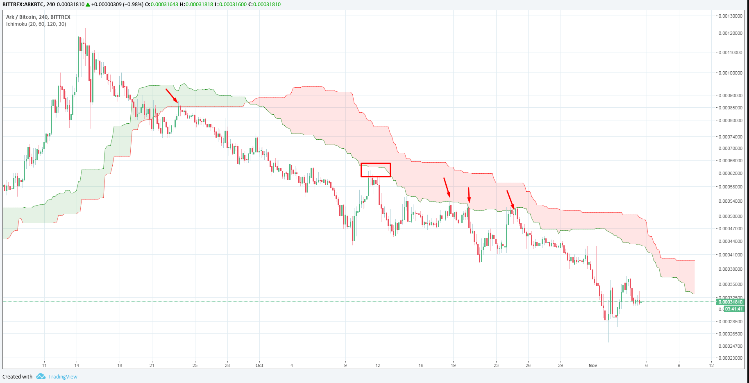

Slide 15
Ichimoku Cloud Trading Strategies
Note: this list is not exhaustive, for the sake of brevity.
Tenkan-Kijun Cross (TK Cross) Ichimoku as an Oscillator
Kumo Breakout
Kumo Edge-To-Edge
Kijun Bounce
Kijun Cross
Kumo Twists/Senkou Span Cross

Slide 16
Crosses Relative to Kumo Cloud
When a TK cross takes place, you must interpret this signal with reference to the Kumo Cloud
E.g. Bullish TK cross above the Kumo is a strong bullish signal, whereas the same TK cross below the Kumo only signals to close shorts
Similarly, a bearish TK cross inside the Kumo is a neutral bearish signal, whereas the same TK cross below the Kumo would be a strong sell signal
In short: the trend increases or diminishes the strength of the signal

Slide 17
Time Frames and Ichimoku
Normal rules apply: higher time frames give stronger and more reliable signals
I mostly use 30m, 1H, 4H, and 1D (and this seems to be quite popular among Cloud traders)
Some coins won’t have enough history for Cloud to work properly, so you can either use a lower time frame or reduce settings to single Cloud as opposed to double (h/t @CarpeNoctom once again)

Slide 18
TK Cross
When the Tenkan Sen (Conversion line) crosses above or below the Kijun Sen (Base line)
In simple terms:
When the blue line crosses from below to above the cherry line, it’s a bullish cross
When the blue line crosses from above to below the cherry line, it’s a bearish cross
Remember to look where the cross is in relation to the Kumo!

Slide 19
BTC/USD 1D - Bullish and Bearish TK Crosses

Slide 20
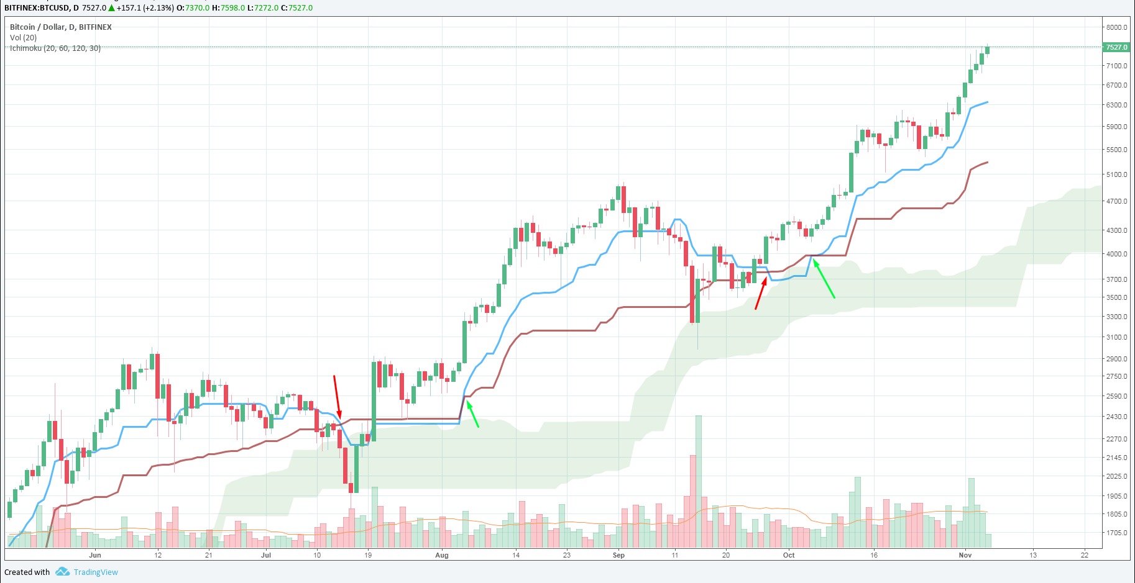

Slide 21
ETH/BTC 1D - Bullish and Bearish TK Crosses

Slide 22
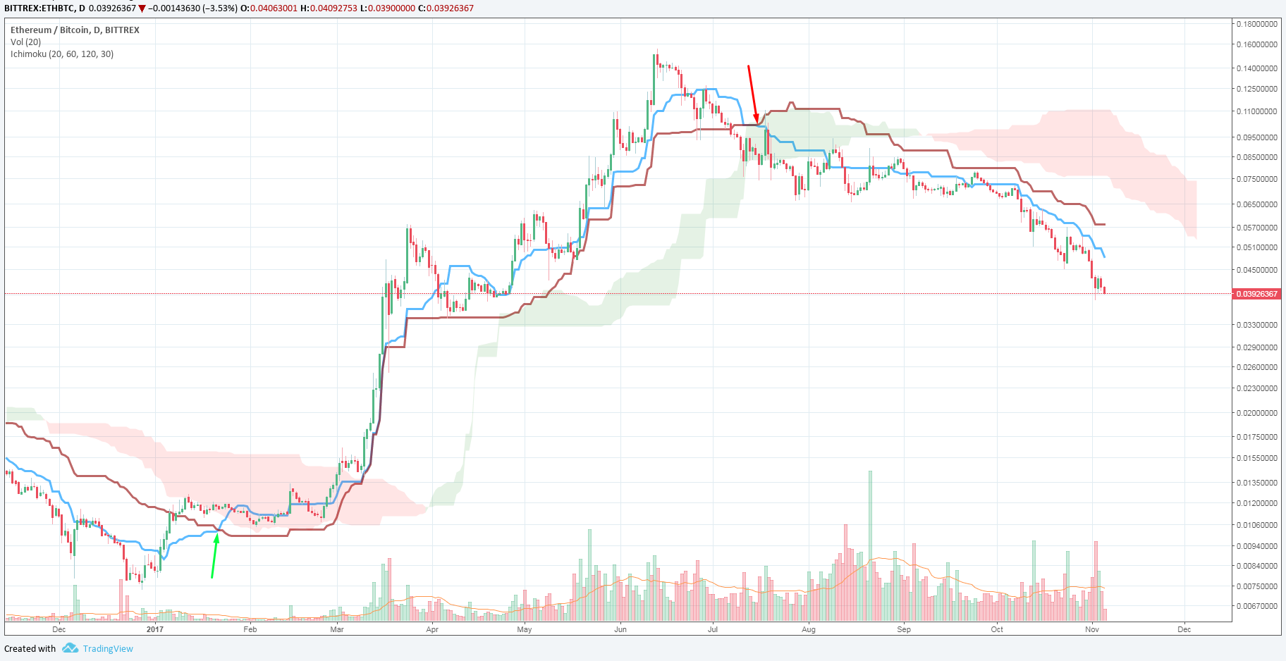

Slide 23
Kumo Breakout
When price breaks above or below the Kumo Cloud
In simple terms:
When price breaks up through the top of the Kumo Cloud, this is bullish
When price breaks down below the last line of the Kumo Cloud, this is bearish
When price is within the Kumo Cloud, this is usually a no trade zone for me, with the exception of an edge-to-edge (to be covered later)

Slide 24
BTC/USD 4H - Kumo Breakouts

Slide 25
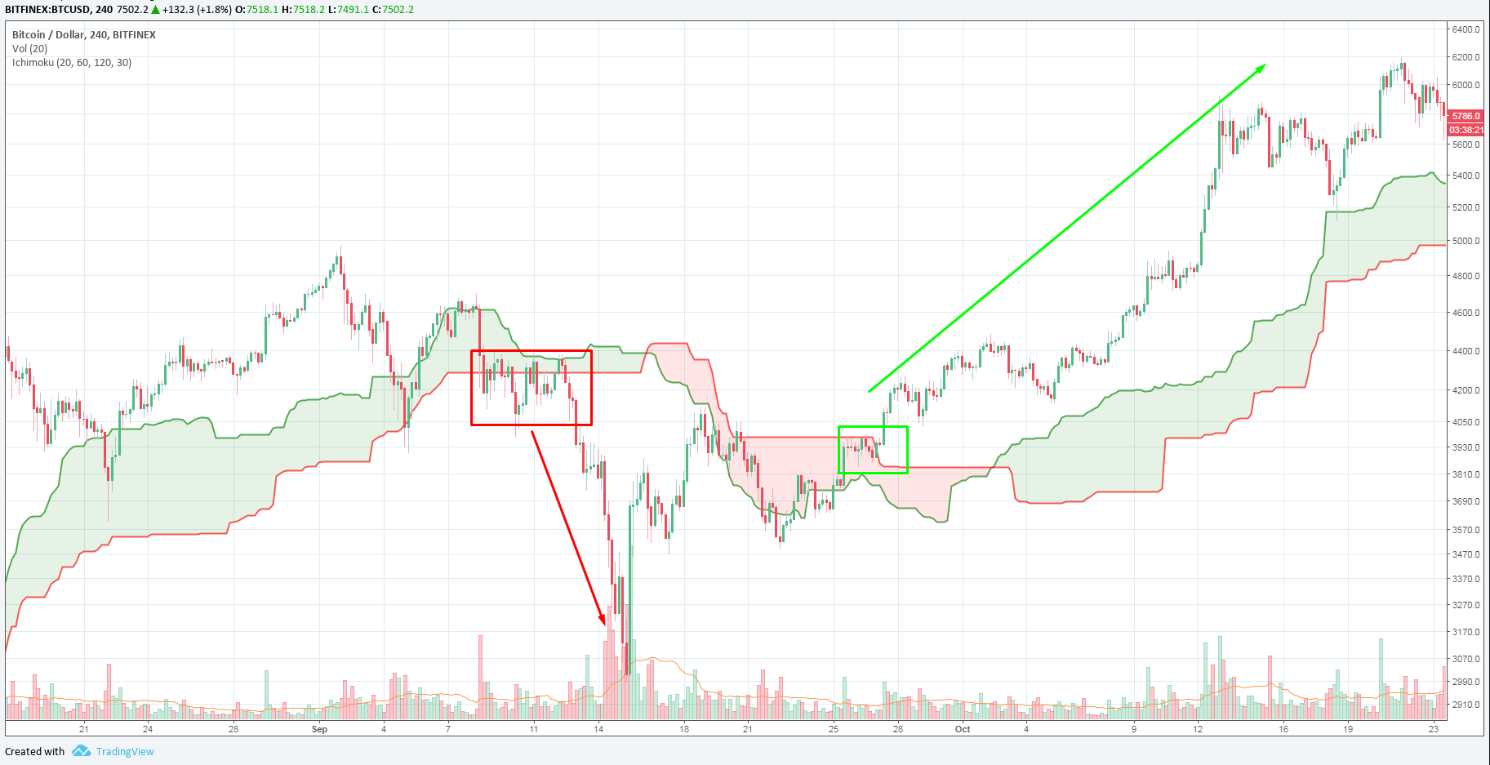

Slide 26
Kumo Edge-to-Edge
When price breaks into the Kumo and there’re candle closes inside it, the target becomes the opposite edge of the Kumo
Use other elements of the Ichimoku Cloud system and other tools (oscillators, moving averages, et cetera) to see if the move is supported
In simple terms:
If price enters the Kumo Cloud and stays there, there’s a reasonable chance that price reaches the opposite end of the cloud

Slide 27
DASH/BTC 4H - Edge-to-Edge

Slide 28
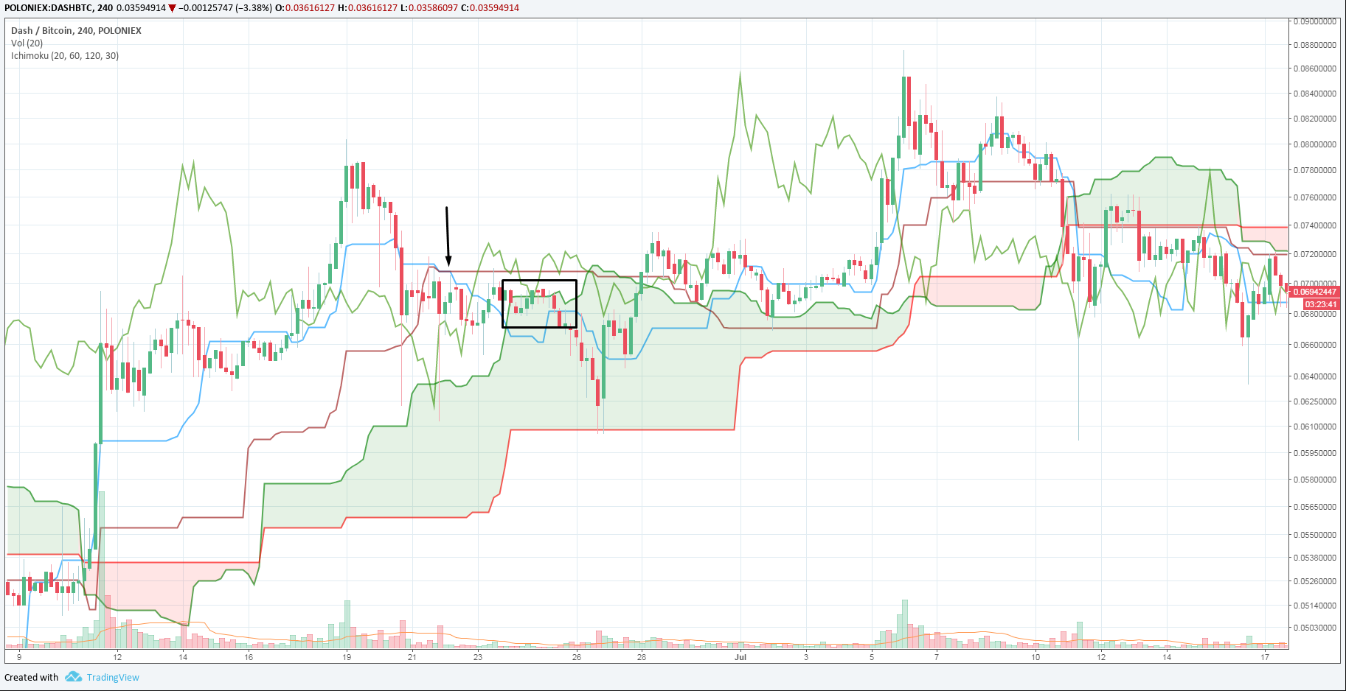

Slide 29
ARDR/BTC 4H - Edge-to-Edge

Slide 30
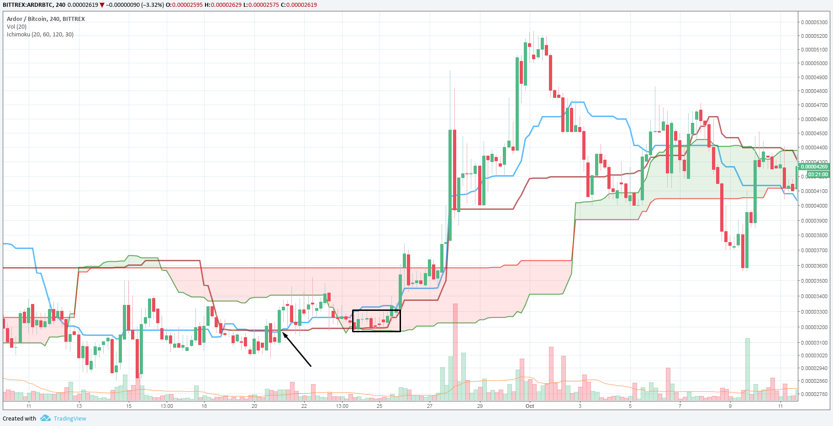

Slide 31
Kijun Bounce
A Kijun Bounce is when price retraces to the Kijun Sen and successfully uses it as a support level
This is the equivalent of price testing a horizontal or trendline support level, and bouncing from there
Thus, placing buys at the Kijun = Ichimoku version of buying support
In simple terms:
A Kijun Bounce is when price tests and bounces off the cherry line. This suggests that the support level has held, and the trend is likely to continue

Slide 32
BTC/USD 4H - Kijun Bounces

Slide 33
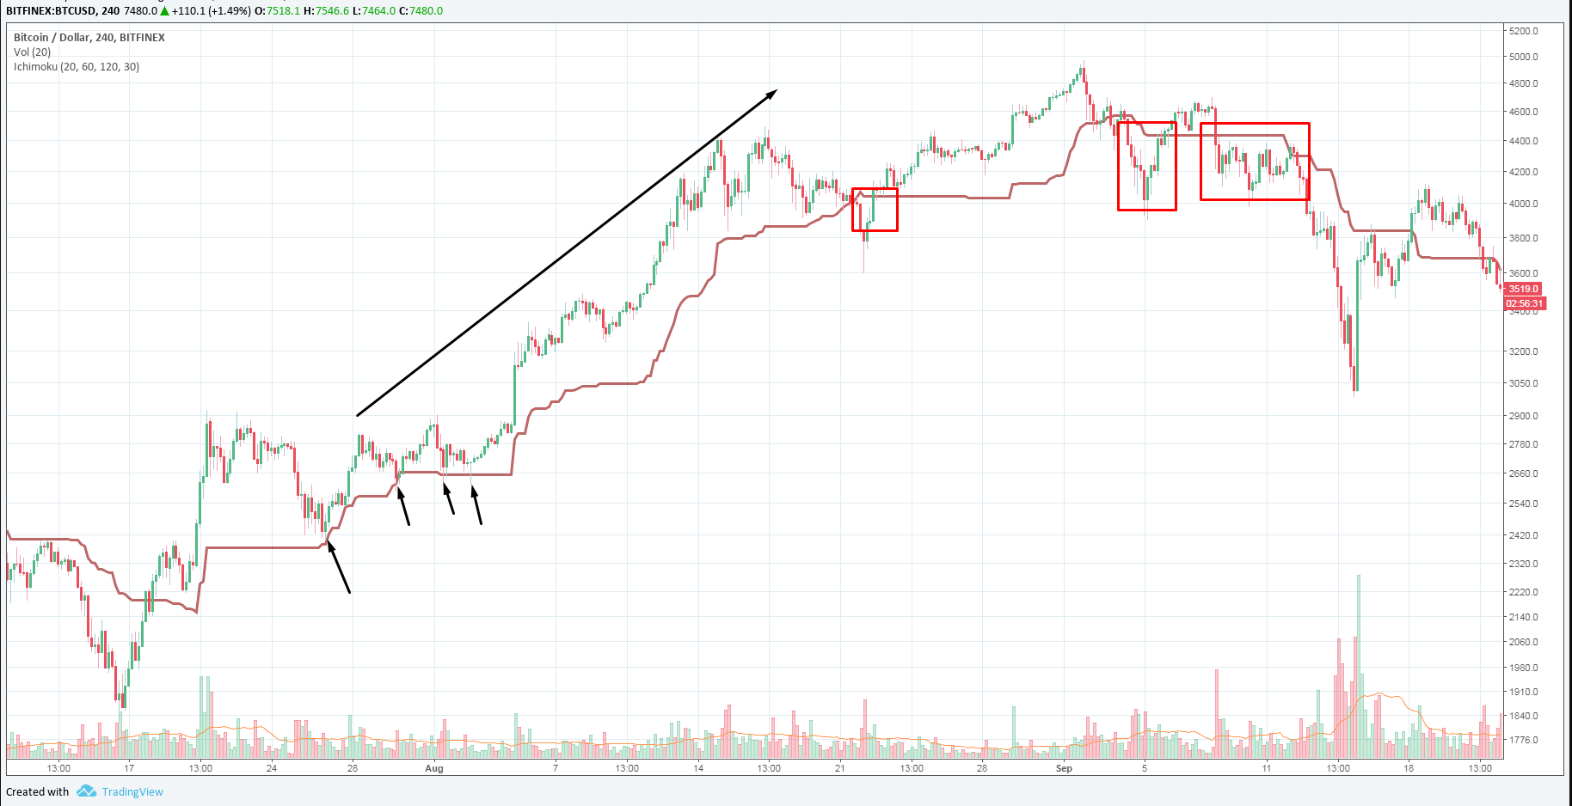

Slide 34
Kijun Cross
When the price crosses above or below the Kijun Sen (Base line)
In simple terms:
When the price crosses from below to above the cherry line, it’s a bullish signal
When the price crosses from above to below the cherry line, it’s a bearish signal

Slide 35
LTC/BTC 1D - Kijun Crosses

Slide 36
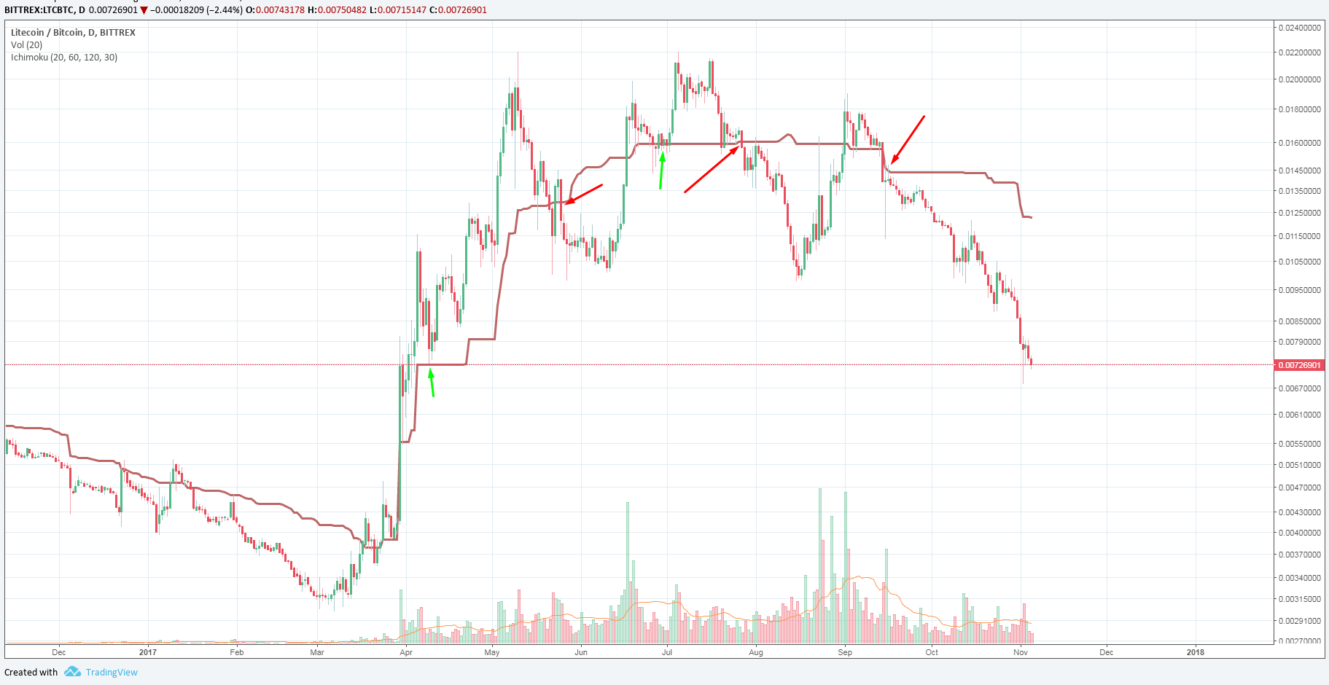

Slide 37
Kumo Twists/Senkou Span Crosses
The Senkou Span Cross signal occurs when Senkou Span A crosses Senkou Span B
Lots of possible signals, but I’ll stick to the simple one:
The future Kumo should reflect the position you’re taking
In simple terms:
If you want to buy, look for the future Kumo to be green
If you want to sell, look for the future Kumo to be red

Slide 38
LTC/BTC 4H - Kumo Twists/Senkou Span Crosses

Slide 39
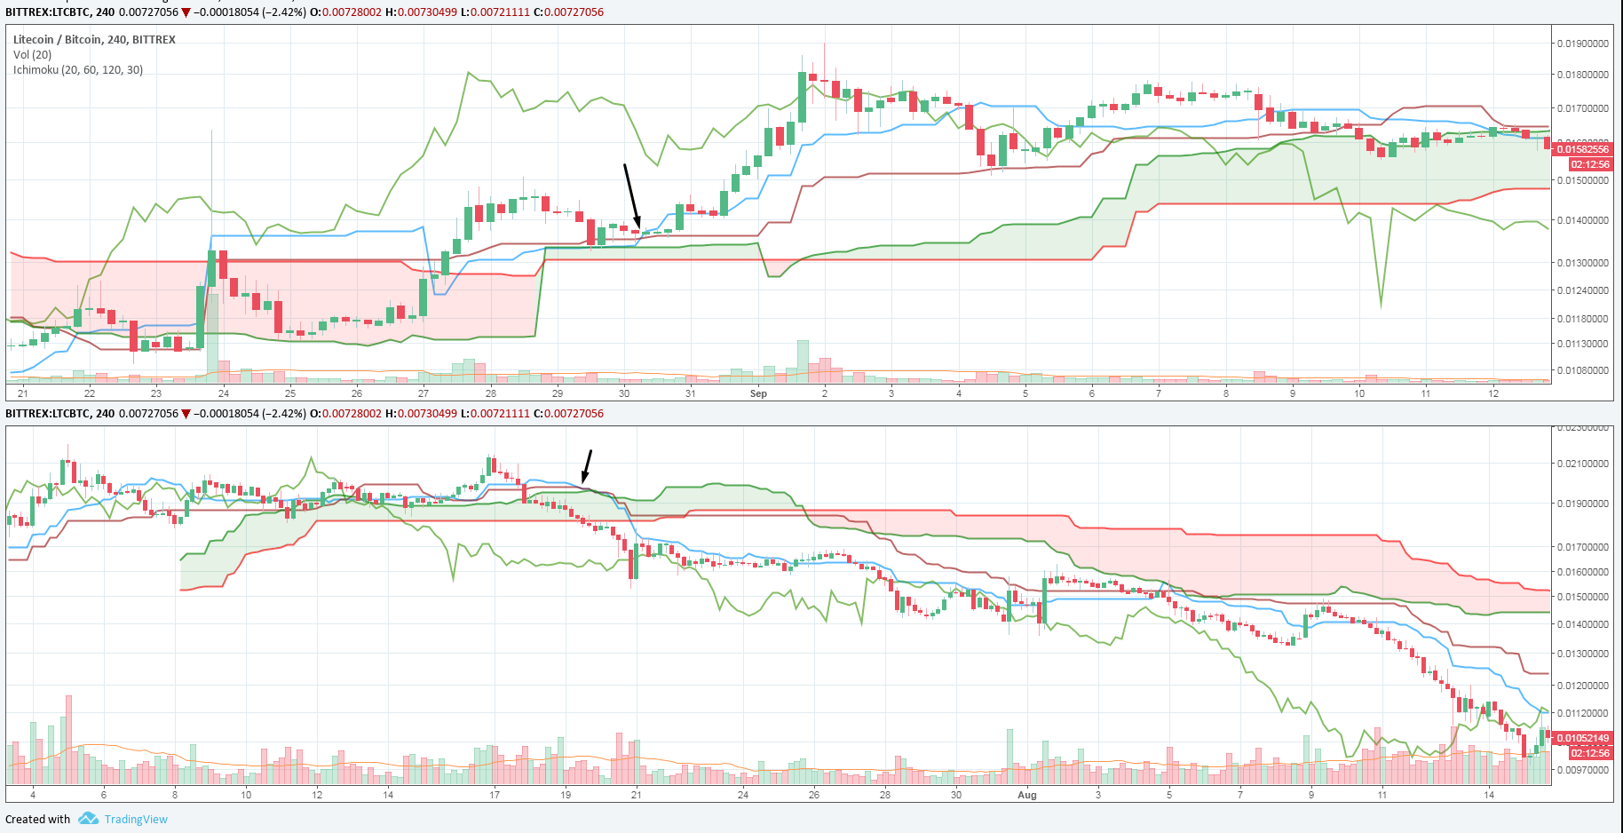

Slide 40
Ichimoku as an Oscillator
The greater the disparity between the Kijun Sen and the Tenkan Sen, the more overbought/oversold the price is (depending on the trend)
This is also known as TK disequilibrium (which corrects and returns equilibrium)
In simple terms:
If the gap between the cherry line and the blue line becomes big, it suggests price will need to correct

Slide 41
BTC/USD 2D - TK Disequilibrium

Slide 42
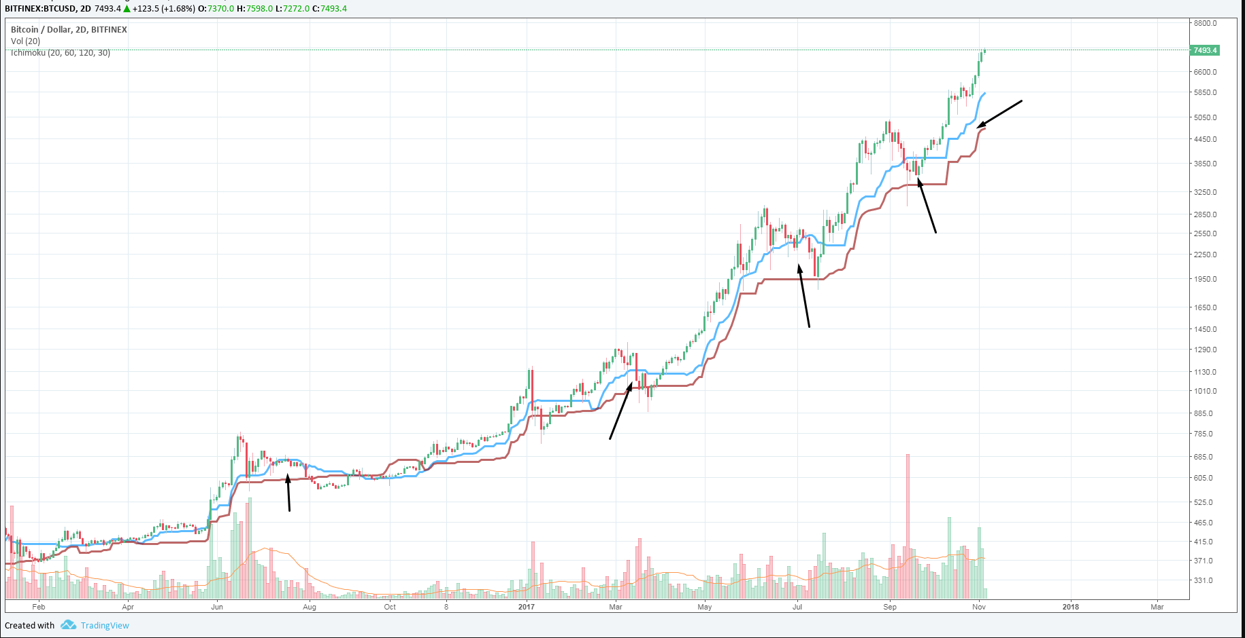

Slide 43
Final Remarks
Put it all together - don’t isolate strategies
Reminder: when trading TK crosses, look at where the cross is relative to the Kumo
See if other indicators support the Ichimoku signal you’re going to follow
#cloudknows

Slide 44
Further Reading
https://bab.teachable.com/courses
http://stockcharts.com/school/doku.php?id=chart_school:technical_indicators:ichimoku_cloud
https://www.youtube.com/user/carpenoctom
https://www.youtube.com/user/ChaosTrader63/videos
http://www.ichimokutrader.com/
http://www.kumotrader.com/ichimoku_wiki/index.php?title=Main_Page

